Slide 1
NORTH AMERICA: SPEAKING OPPORTUNITIES PROGRAM

Slide 2
VERIFONE SPEAKER PROGRAM
Program Objectives
Consolidate speaker pool – key executives
Emphasize strategic topics
Reduce off-message presentations
Improve efficiencies through reusable content
Consolidate point of contact for speaking requests

Slide 3
SPEAKING OPPORTUNITY CRITERIA
EVALUATION CRITERIA
Visibility
Media and analyst coverage
Prestige / Credibility of organizer
Customer, partner attendance level
Relevance
Content relevance to business objectives
Audience Profile
Customer, partner attendee level (e.g. decision maker?)
Cost
Paid vs. earned speaking opportunity
VeriFone investment in event
Partner, competitor spend
SUPPORT LEVEL
Tier One
Coordinate earned submissions Coordinate content for paid opportunities Manage logistics (excluding speaker travel) Develop event-specific communications plan Provide on-site communications support
Tier Two
Coordinate earned submissions Coordinate content for paid opportunities Manage logistics (excluding speaker travel) Coordinate on-site media and analyst briefings
Tier Three
Refer to regional marketing teams Review presentation content

Slide 4
NORTH AMERICA: Q2-Q3 PROGRAM EMPHASIS
North American Strategy
Primary: Jennifer Miles
Secondary: Erik Vlugt
Mobile Wallets
U.S. EMV Migration
Mobile Retail
Managing Payments Complexity
Adoption hurdles
Security
Technology wars
Deadlines / drivers
Hospitality impact
Retail adoption
Customer experience
Device integration
Security
Training / culture
Cloud solutions
Compliance burden
Mobile complexity
Security
Primary: Erik Vlugt
Secondary: Dave Talach
Security: Marc Masser
Primary: Erik Vlugt
Secondary: Randy Burnette
Hospitality: Drago Dzerve
Primary: Sandeep Bhanote
Secondary: Harlan Eplan
Security: Marc Masser
Primary: Jeff Wakefield
Security: Marc Masser

Slide 5
NORTH AMERICA: CURRENT 2013 TARGETS*
Event | Date
TIER 1
National Retail Federation NRF | January 13-16
ETA 2013 | April 30-May 2
NRA | May19-20
NACS | October 10-15
TIER 2
SCA – Annual Summit | Feb. 5-7
NFC & Mobile Money Summit | Feb. 22-25
Card Forum & Expo | Apr. 7-10
Mobile Payments Conference | April 10
Retail Technology Conference | April 10-12
Global Retailing Conference | April 11
RAMP | April 15
All Things D – Dive into Mobile | April 15-16
CARTES America | April 23
IRUG | April 21-24
Event | Date
MasterCard Risk Conference | April 28 – May2
The Tech Event (formerly NACS tech) | May 6-10
SCA – NFC Summit | May 15-16
CTIA Wireless | May 21-23
Retail Executive Summit | June 13
2013 Mobile Banking & Comm. Summit | June 3-5
Cardware 2013 | June 19-20
Mobile Commerce World | June 24-26
FORTUNE BrainStorm Tech | July
Shop.org | Sept. 30 – Oct. 2
Money2020 | Oct. 6-9
GigaOm Mobilize | Oct. 16-17
MobileCON (formerly CTIA Ent.) | Oct. 16-18
ATM Debit & Prepaid Forum | Oct. 20-23
*Target list is fluid and will evolve as new events are vetted

Slide 6
SPEAKER REQUEST PROCESS: TARGET EVENTS
1. Communications tracks and monitors Call for Proposals deadlines
2. Communications works with spokespersons to identify topics and draft submissions
3. Speaker reviews and approves submission
4. Communications submits proposal and works with event organizer to provide additional information and influence decision as needed
5. Once confirmed, Communications manages logistics (excluding speaker travel), speaker prep and works with regional marketing to develop presentation materials (if necessary)
6. After speaking opportunity, Communications follows up with speaker for post-event feedback

Slide 7
SPEAKER REQUEST PROCESS: NEW EVENTS
1. Speaker Request submitted to Communications Internal requests can be sent to the i_publicrelations distribution External requests can be made by completing the “Request a Speaker” form on the VeriFone.com Press Room or Events page
2. Communications reviews event and evaluates speaking opportunity
3. Communications tracks and monitors Call for Proposals deadlines
4. Communications works with spokespersons to identify topics and draft submissions
5. Speaker reviews and approves submission
6. Communications submits proposal and works with event organizer to provide additional information and influence decision as needed
7. Once confirmed, Communications manages logistics (excluding speaker travel), speaker prep and works with regional marketing to develop presentation materials (if necessary)
8. After speaking opportunity, Communications follows up with speaker for post-event feedback

Slide 8
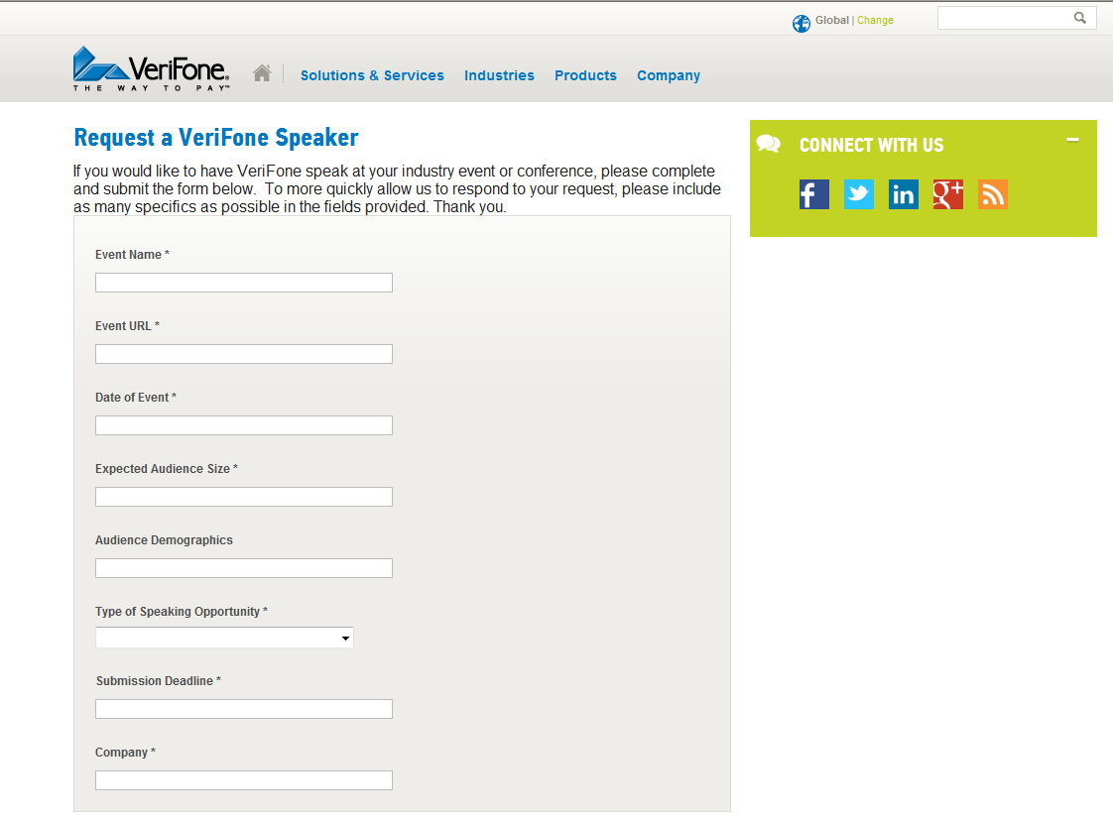
VERIFONE SPEAKER REQUEST ONLINE FORM
Web form available on verifone.com Press Room and Events pages

Slide 9
NEXT STEPS
Discuss program with internal stakeholders; incorporate input
Discuss and implement measurement
Recalibrate event target list as appropriate
Socialize with N.A. marketing and executive teams

