Slide 1

ELDS North America Communications
2025 Mission and Planning

Slide 2
Our Mission
We empower both our internal and external customers through open communication, curiosity, and collaboration. We commit to responsiveness, proactivity, and respect, understanding and addressing the needs of our team members and the communities we serve. By asking 'why?' and embracing new perspectives, we deliver clear, honest, and credible communications that give everyone a voice, showcase the value of our work, and strengthen our collective impact on the business and the world.

Slide 3
2025 Objectives
Create a Marcom Center of Excellence
From our product web pages to our conference signage, we want to ensure consistency and a “customer first” philosophy in everything we create.
Ensure cross-functional Integration with sales, product, portfolio, operations, and leadership, so that everything we do answers the question, “This ties back to our strategy of (x).”
Develop a “One NA ELDS” Internal Communications Program
Create a regular cadence of top-down communication to keep everyone informed and engaged with their BL.
Continue to build a culture of open communication and continuous improvement, giving everyone an opportunity to engage and be part of the future of the NA ELDS BL.
Market Awareness and Lead Gen
Expand awareness for ELDS products in North America.
Use Marcom activities effectively to generate new leads.
Maximize and amplify our product launch and product communication activities so they aren’t just “publish once and done.”
Build and support the brand at the local and national levels.
N
G
W
I
&
S
V
E
N
A
E
C
M
I
L
I
T
Y
N
G
O
O
A
R
T
S
S
E
H
S
S
N
E
O
S
M
E
E
L
R
R
R
C
E
A
E
‘
O
W
U
S
‘
O
R
S
Y
O
S
E
L
E
A
M
C
R
O
C
S
A
G
H
E
V
W
N
E
A
T
I
N
&
N
O
W
E
C
C
L
A
N
S
O
M
S
I
E
S
S

Slide 4
Communications Vehicles
Owned and Managed by ELDS Comms
(Ours to control)
ELDS Comms can directly contribute to
(Guest pass only)
ELDS Comms owns but does not have direct access to
(Like having the Ferrari in the garage, but no keys)
ELDS Comms does not own and has no direct access but can request posting
(Ask nicely)
Teams
Internal Email Lists
EL Teams Channels
ELDS US product web pages
Inside+
External Email Lists
Videoconferencing
EL Viva Engage
Plant-specific comms vehicles
External Media Pubs
Viva Engage
Sharepoint
Local
Social Media
Global Social Media

Slide 5


North America ELDS Communications Core Responsibilities
Support Local Division Priorities Aligned with Global
Integration with Sales: Collaborate with sales teams to align marketing strategies with sales goals. Regular meetings help refine tactics based on field feedback.
Localized Campaigns: Create localized marketing campaigns that align with global messaging while adapting to cultural and market differences.
Customer and Industry-wide Communications
Top-of-Funnel Marketing: Develop a strategy covering Awareness and Lead Gen Marketing for NA ELDS Campaigns and Product Launches:
  Awareness: Use thought leadership, PR, and social media for brand recognition.
  Consideration: Engage prospects with webinars, whitepapers, and case studies.
  Lead Generation: Capture leads via email marketing, paid search, and social ads.

Slide 6
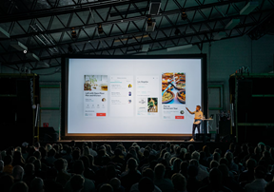

North America ELDS Communications Core Responsibilities
Business-line Conferences and Trade Media
Events: Support multi-BL events with content and messaging, presenters, and product-level expertise. For ELDS-only events, work with local events teams to define key events, SMEs, content, marketing plan, and KPIs to maximize ROI.
Trade Media: Work with Tier 2 trade media to promote ELDS press releases and thought leadership. Work with journalists to promote topic ideas that inform ABB audiences and drive awareness of ELDS’ business. Develop advertising programs as-needed to promote campaigns, product launches, and/or lead-gen activities.
Portfolio and Product Support
Product Launch: Work with teams on all new product launch activities. Develop content relevant to the launch. Provide messaging and project management support to ensure key deliverable timelines are met.
Omni-channel Launch Strategy: As needed, develop and execute—either alone or with other local or global teams—content and messaging to support product launches. Channels include both internal and external promotional vehicles.

Slide 7

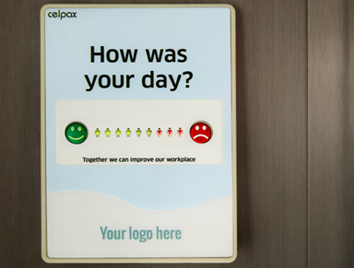
North America ELDS Communications Core Responsibilities
Customer Success and Digital Content
Storytelling: Craft compelling customer and organizational stories and narratives that promote the business’ brand and culture.
Digital Content: Develop and manage a digital strategy for ELDA NA product content on the web.
  Initially, work with the Global ELDS Comms team and local Portfolio team to streamline and optimize existing product pages.
  Establish a regular cadence of page reviews with product owners to ensure pages are updated as necessary.
  Regularly audit all pages for performance, broken links, etc.
  Address performance issues as needed.
Internal Communications
Content Planning: Create a content calendar—shared with Global ELDS Comms, including product launch key dates, internal communications, and major campaign dates.
Engagement: Work with Sales, ELDS Leadership, Portfolio teams, Marketing, Global Comms, and Plant Managers to deliver regular, impactful communications.
  Town Hall
  Leadership messages
  Quarterly business updates via email
  Sharepoint site updates
  Viva Engage posts
  New Inside+ local page
  Other as determined

Slide 8












Thought Leadership and Market Awareness
Thought Leadership
Media Engagement
White Papers
Sustainable practices in electrification manufacturing
The benefits of hydrogen fuel to power an evolving energy grid
The importance and benefits of Condition Monitoring
Preparing for the Energy Transition: Challenges and Opportunities in Evolving Grid Infrastructure
Webinars & Educational Content
All of the above
From Concept to Reality: How Partnerships Are Powering the Energy Transition
Building the Resilient Grid of the Future: Strategies for Adaptability and Sustainability
Case Studies & Customer Success
By customer type
By segment
By strategic focus area
Events & Conferences
Identify speaking/panel opportunities
Objectives
Strengthen brand visibility in energy and technology publications
Position our company as an industry leader and innovator
Build relationships with key journalists and editors
Engagement
    Press Releases - Ensure consistent, relevant news coverage on product launches, partnerships, and milestones.
    Story Pitching - Develop and pitch feature ideas highlighting our solutions and impact on the energy industry.
    Media Briefings and Interviews - Arrange interviews with executives to provide insights and industry perspectives.
    Thought Leadership Articles - Place opinion pieces and bylined articles that showcase expertise on emerging trends.
Expected Outcomes
Enhanced organic visibility in trade pubs
Greater credibility and thought leader positioning
Increased stakeholder and partner engagement

Slide 9
Portfolio and Product Support
Communications is a key part of the Product Launch process, with a specified set of deliverables necessary to move each launch forward.
Communications’ role in this process is complex:
Messaging
Project Management
Content Development
Campaign Strategy
(as needed)
New templates and intake forms to streamline Comms planning and execution.
Assist Portfolio and Product
Teams to develop product-
level messaging and key messages.
Establish new messaging documentation to support personal and/or segment-specific markets.
Ensure brand and style is maintained across all communication vehicles.
Define communications plan on a per-launch or per-project basis.
Work with internal and external stakeholders to ensure project deliverables stay on time.
Manage budgets and agency resources effectively.
Distribution and promotion of Communication deliverables.
Communicating deliverables to both internal and external stakeholders and employees.
Create a content strategy fitting specific types of product launches, campaigns, and communication deliverable.
Content execution:
Writing/editing
Working with design agencies
Managing internal reviews and draft changes
Finalizing and storing final versions.
Editorial review for all product-level DS content prior to distribution.
Translate globally-created campaigns for use locally.
Maintain collaboration with Sales leaders, Portfolio, and Product teams, ensuring our Comms focus in on revenue-driving opportunities.
Build DS-specific campaigns to support EL or DS themes, products, or initiatives.
Channel selection
Content and asset creation
Budget management
Timeline and milestone development
Collaboration
Launch and execution
Monitoring and measurement

Slide 10

North America ELDS Communications Core Responsibilities
Additional Responsibilities
Data-Driven Decision Making: Leverage analytics to measure the effectiveness of Communications campaigns and processes. Continually look for way to streamline and improve not just how Communications works, but how it works across the organization.
Cross Functional Collaboration: Ensure close collaboration between Comms, Product Marketing, the Portfolio teams, Marketing, and Communications to align messaging, ensure projects stay on time and on-budget, and optimize the product launch process to maximize the value of launch activities and deliverables.

Slide 11








Building Campaigns for Impact
Global Campaigns
Support global brand messages and core themes (e.g., innovation, sustainability, and digital transformation).
Adapt Global assets for North American audiences, ensuring relevance while maintaining brand consistency.
Collaborate with Global teams to leverage flagship campaigns for regional amplification.”
Grid Digitization
Semiconductors
Datacenters
Hydrogen
Shared Goals
1. Strengthen brand positioning
2. Driving customer engagement
Local Impact
3. Measuring campaign effectiveness
Develop campaigns tailored to North American industry trends, market needs, and customer insights.
Focus on regional goals like increasing market share, enhancing brand awareness, and generating qualified leads.
Incorporate locally relevant channels and formats, such as industry trade shows, webinars, and regional thought leadership content
Build American, Buy American
Smart Grids
Reliable Energy Flow
Bridging Medium-Voltage for Modern Demands

Slide 12
Customer Success and Digital Content
Our digital content provides the intellectual justification our customers need when making purchasing decisions, but
customer success stories make them feel that the decision they’re making is the right one.
For 2024 -2025, we are implementing a 3-stage, repeatable digital
content process:
Our Customer Success Story Recipe
1
2
3
Be Real: Whenever possible, we name the customer.
Be Interesting: We want to use video, success data, show results.
That means we don’t have a “success story” until we have success metrics.
Be Relatable: Share customer stories that resonate the problems our
other customers are having.
Audit: We are currently auditing our switchgear pages and building recommendations. Once we complete the updates on these, we will start the process over on another section of the US product pages.
Update: Working with the portfolio team, we will decide how best to consolidate our existing product pages. Once complete, Communications will begin a page update and refresh, including a messaging exercise, removal of any old advertising, and cleanup of outdated or irrelevant downloadables.
Maintenance: As part of our product launch process, we will implement a bi-annual page review process, ensuring each product page receives an eyes-on audit by its respective product manager twice a year. We will also be regularly reviewing page analytics and making adjustments as needed.
Q4 = 1
Q3 = 1
Goal of one per quarter.
We will need everyone’s help in securing, coordinating, and executing these.
Q2 = 1
Q1 = 1
As agreed upon with the Marketing team, DS Comms is responsible for updating
and managing the content of the US product pages.
90% of Case Studies don’t contain the necessary components
to pique the target audience’s interest – Gartner

Slide 13
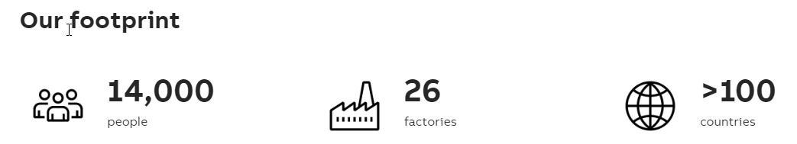
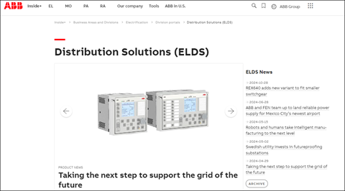
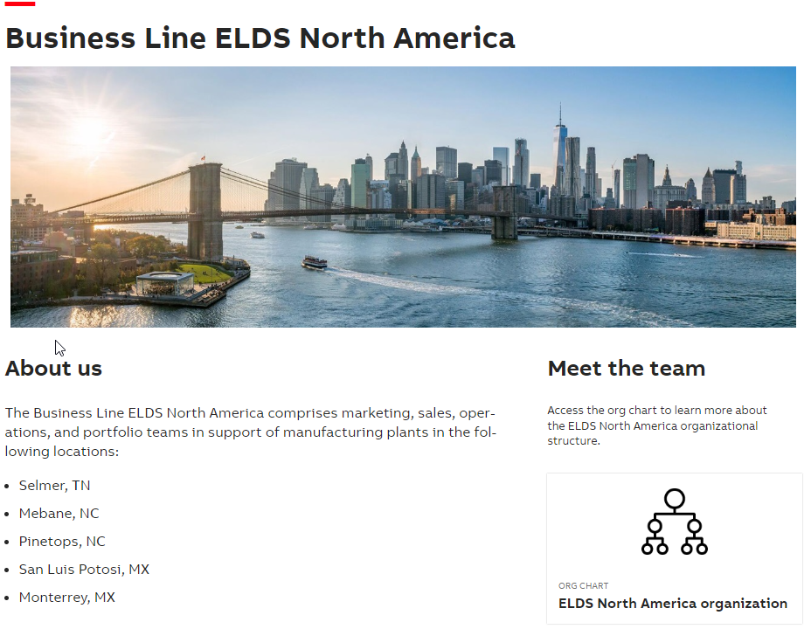
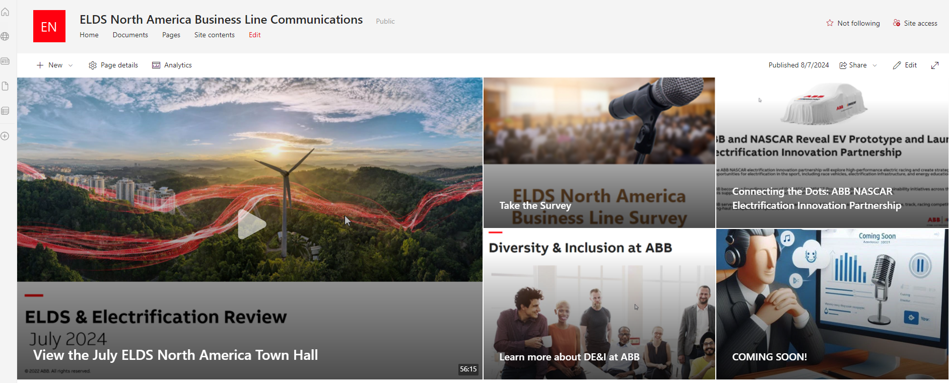
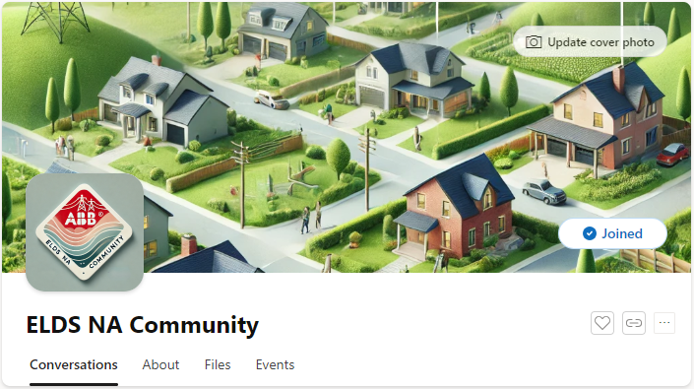
Internal Communications
2024-2025 Planning
ALL Employee and Agents
ELDS Quarterly:
Business Update – Email
Town Hall – Webinar
Monthly:
(EL) Leadership Message – Voice message via email
Regular BL updates as they happen:
Shared via LinkedIn or other Social
New ELDS NA VIVA Engage page (published)
New Sharepoint site for external agents
EL Quarterly:
Town Hall – Support for
next 6-12 months then
take over.
Who is ELDS
Globally?
And who is ELDS NA?
Phase 2
Phase 1
Audit of internal ELDS Inside+ pages.
Implement feedback mechanism for removing/updating outdated content and pages.
Incentivize employees to update their Delve profiles.
Manufacturing Plants
Work with plant managers to determine best process
for communicating with employees based on current
processes, languages spoken, and comms vehicles.
Support local Marketers with creative and brand guidance.

Slide 14
Additional Responsibilities and Focus Areas for Improvement
Data Driven Decision Making
Cross Functional Collaboration
Process Improvement
Use KPIs and feedback to continuously monitor and adjust strategies and tactics.
Always asking questions:
Why are we doing this?
Should we be doing this?
Should we be doing more or less of this?
Would our resources be better used elsewhere?
We all need each other, and each other’s input.
Sales can tell Comms what customers think about “x.”
Marketing can help Comms execute.
Product and Portfolio teams are the knowledge keepers.
Leadership team helps remove barriers and add their expertise and influence to our activities.
Currently, we lack processes in many areas and some of the processes we do have, are ill-fitted for their purpose. Ares of improvement for 2025:
Project planning and tracking
Document storage
Intake documentation
Project Management
Templates

Slide 15
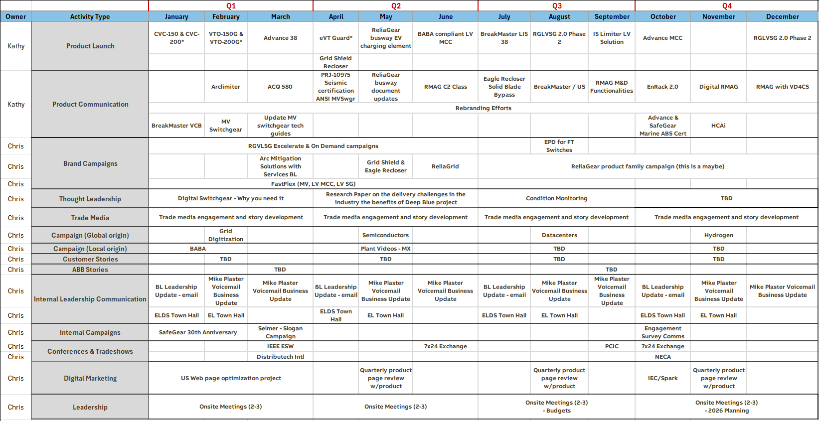
Activities Calendar

Slide 16

ELDS Communications Team
Chris Souther
ELDS NAM Communications
Contact Information
Chris Souther – Chris.Souther@us.abb.com
Existing Team
Product Launch Manager
New Hire
Internal Communications Manager
Owns:
Product Launch and Product Communications
Content Versioning and Storage
US Web Product Pages
Owns:
ELDS Leadership Internal Communications
Plant Comms
Customer Success

Slide 17
Questions?

Slide 18
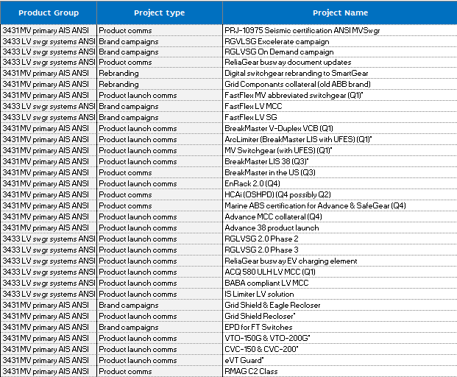
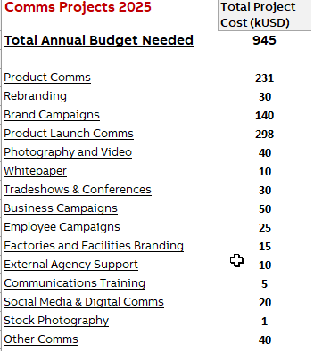
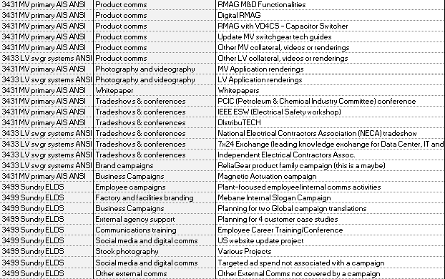
ELDS Budget Request - 2025
Link to spreadsheet

